Slide 1


GAN
Machine Learning Laboratory
Jaeseung Heo
Slides provided by Seungbeom Lee
POSTECH A.I
jsheo12304@postech.ac.kr

Slide 2
Table of Contents
GAN
Review the key points
Practice

Slide 3
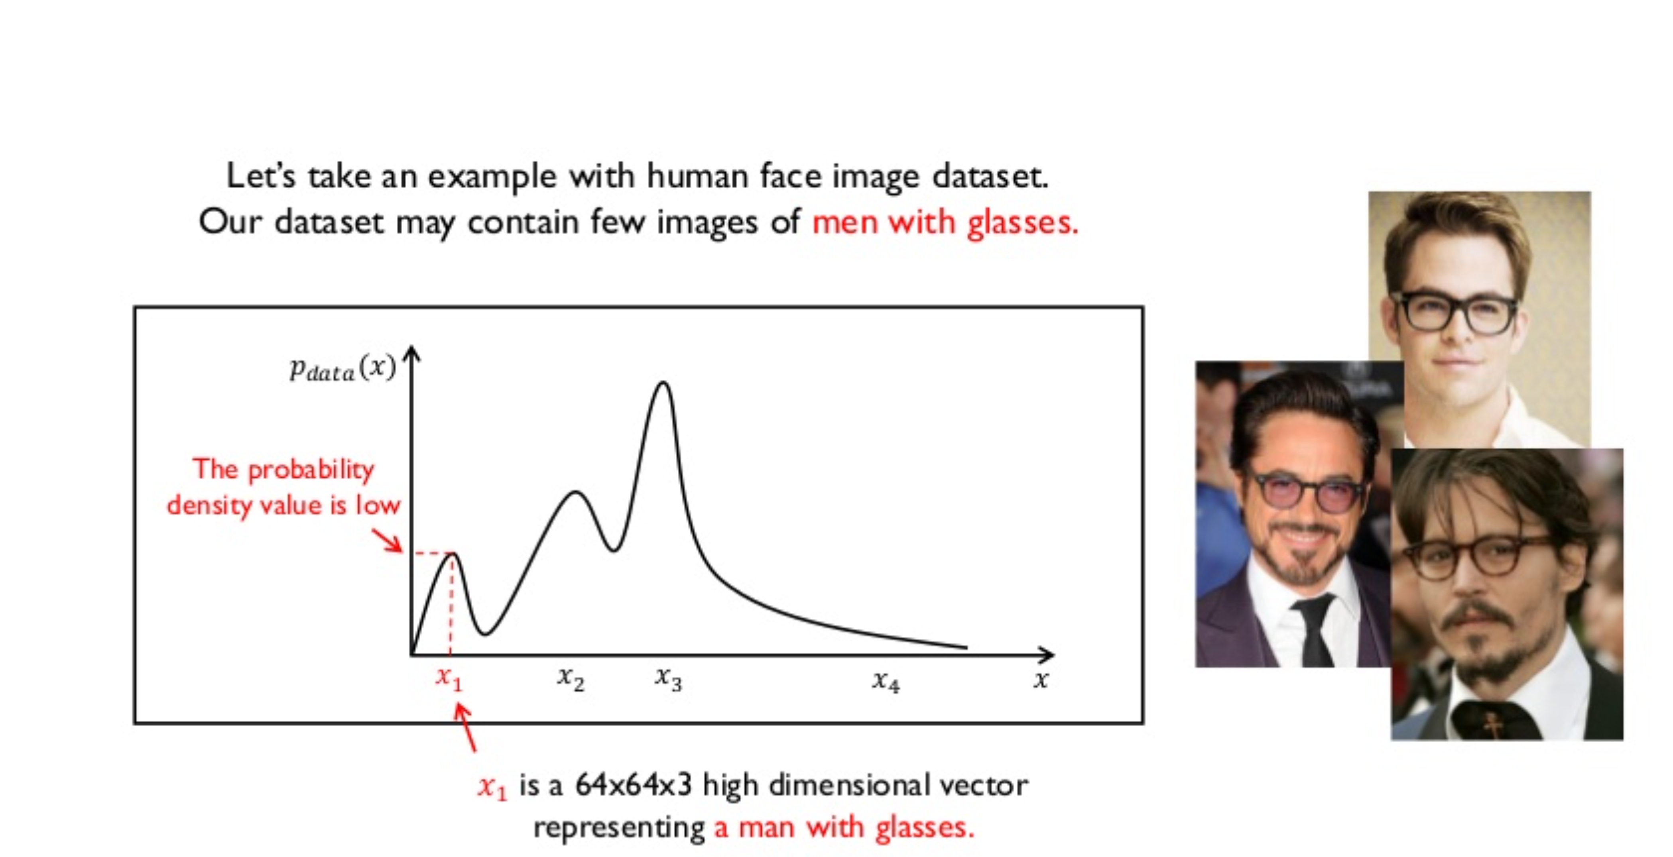
Review
출처: https://www.slideshare.net/NaverEngineering/1-gangenerative-adversarial-network

Slide 4
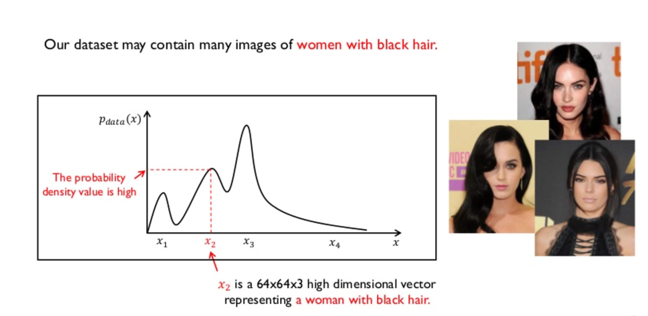
Review

Slide 5
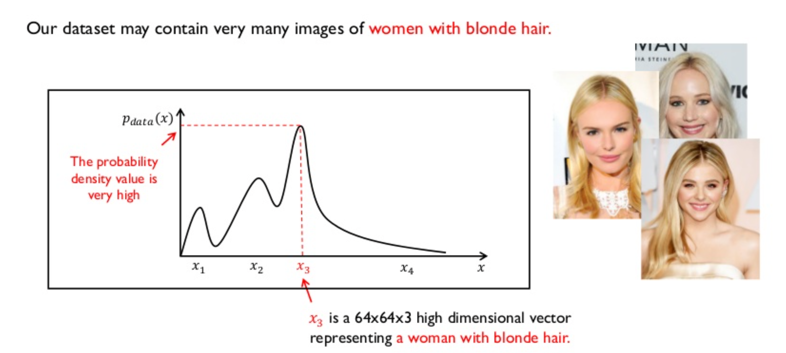
Review

Slide 6
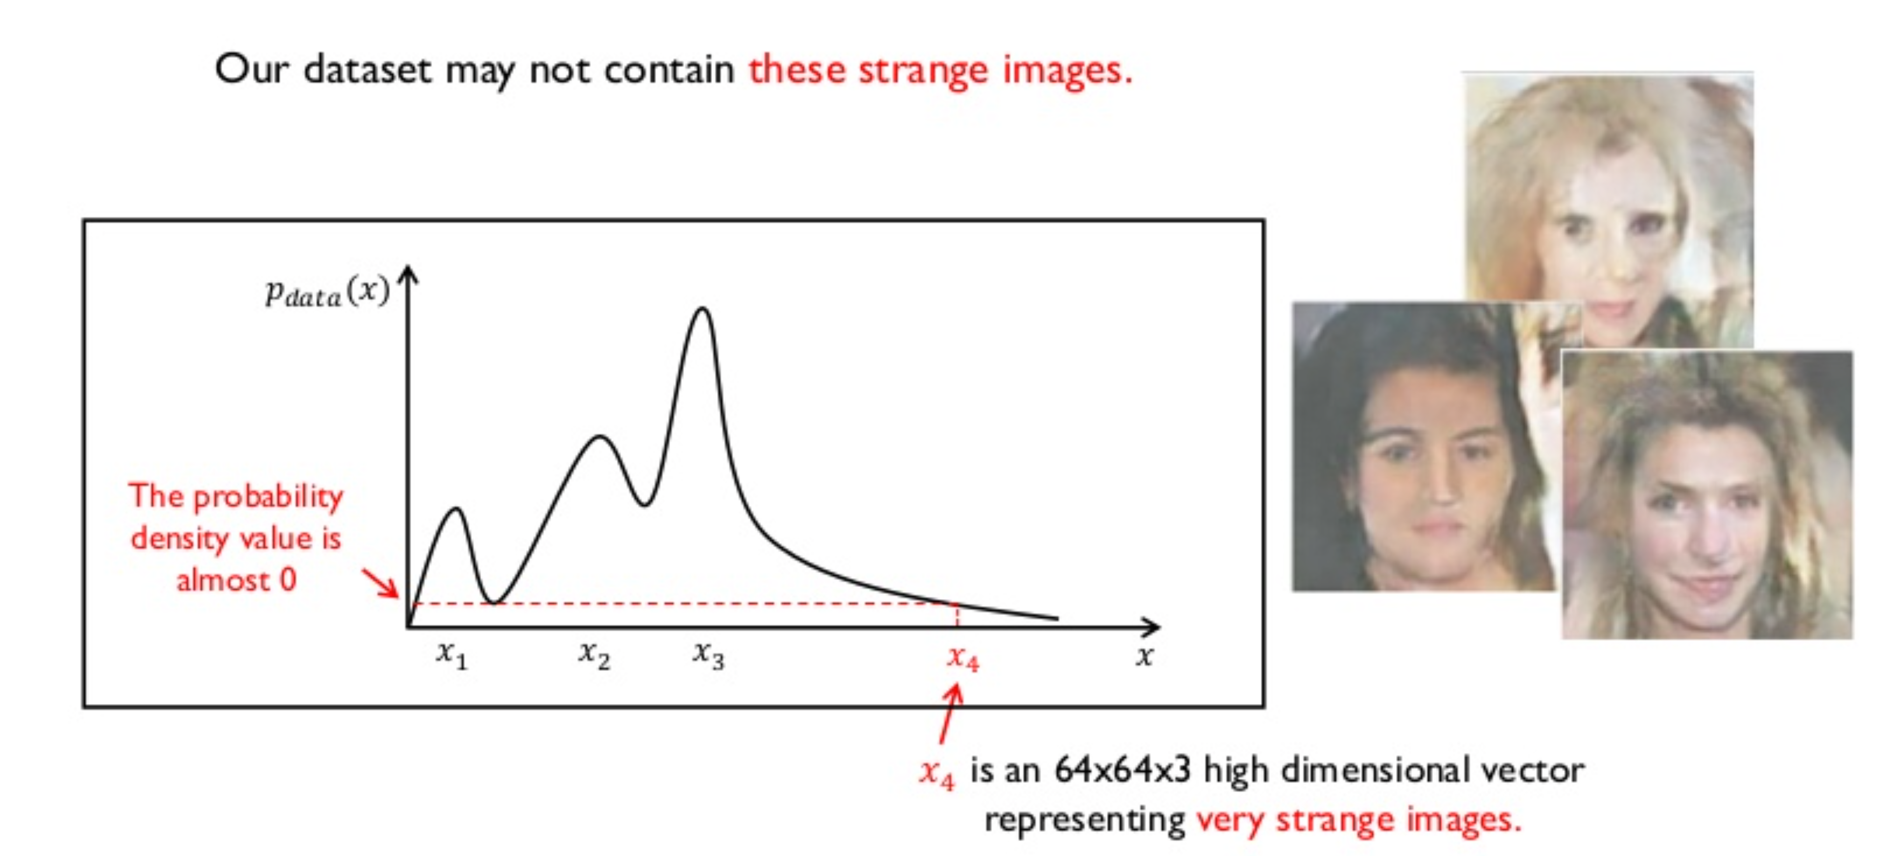
Review

Slide 7
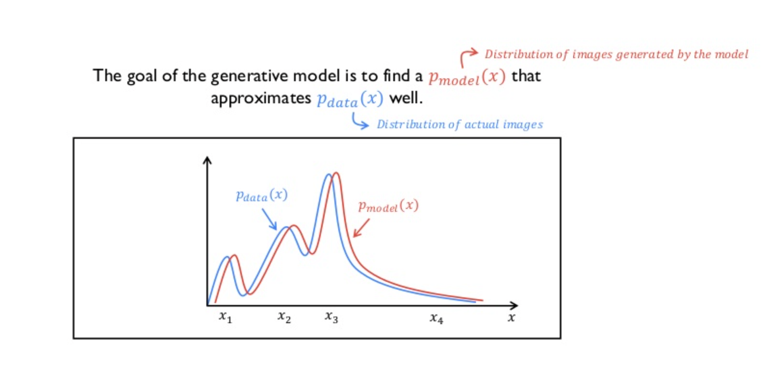
Review

Slide 8
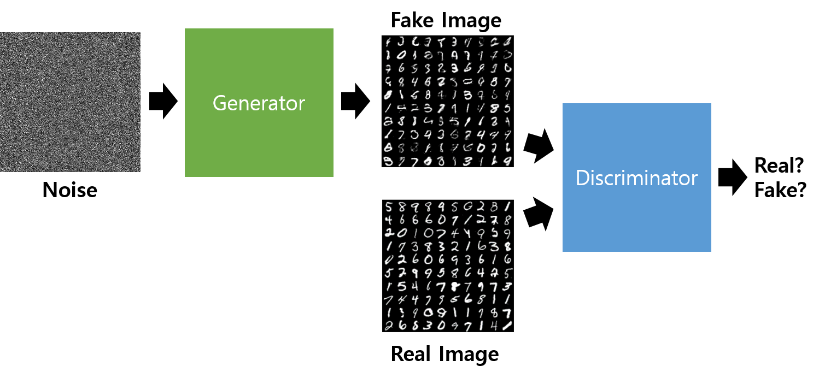
GAN (Generative Adversarial Network)

Slide 9
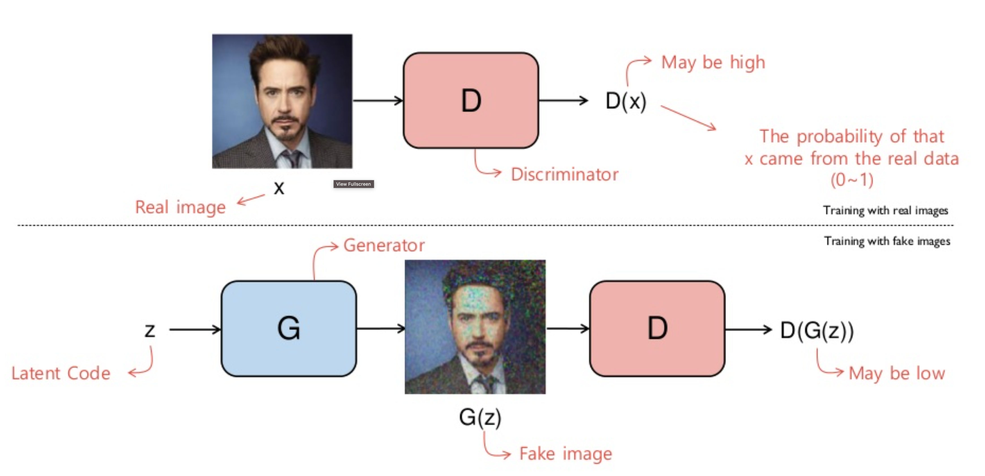
Review

Slide 10
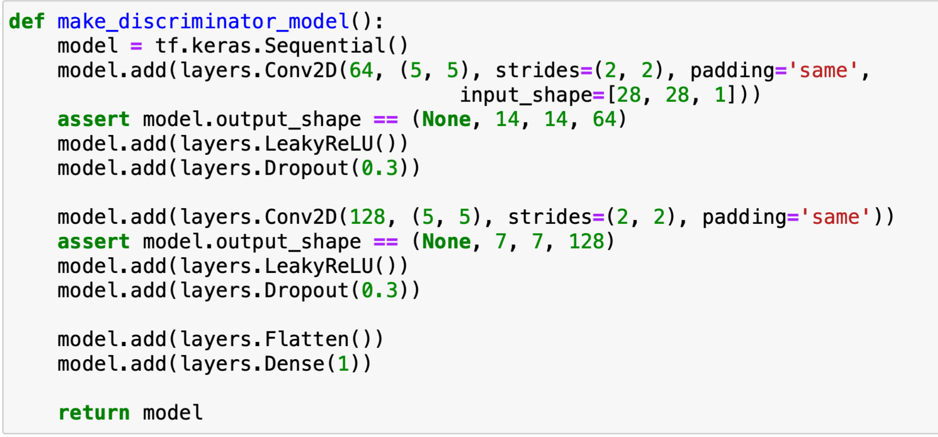
Review

Slide 11
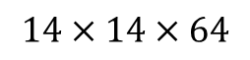
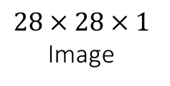
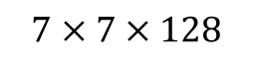
Discriminator structure
Convolution
Dense
Real
or
Fake
$$28×28×1$$
Image
$$14×14×64$$
$$7×7×128$$

Slide 12
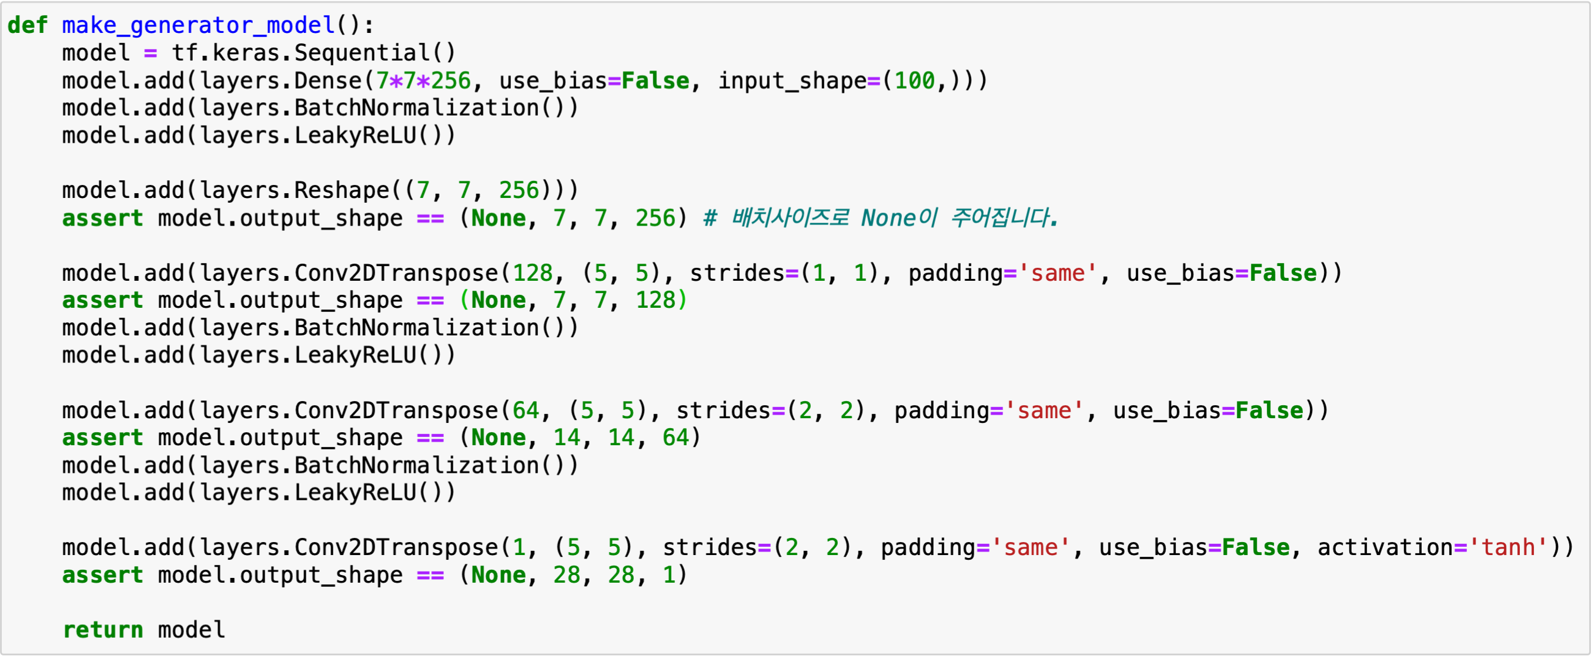
Review

Slide 13
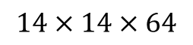
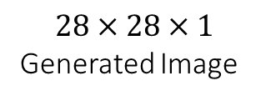
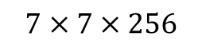
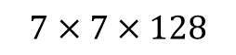
Generator structure
Dense+Reshape
Transposed Convolution
$$7×7×256$$
$$7×7×128$$
$$14×14×64$$
$$28×28×1$$
Generated Image
Random Input

Slide 14
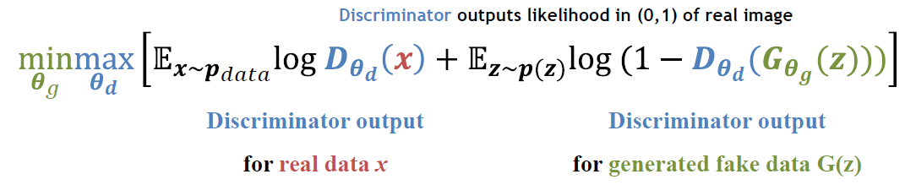
Loss function
Generator tries to minimize the loss
Discriminator tries to maximize the loss

Slide 15
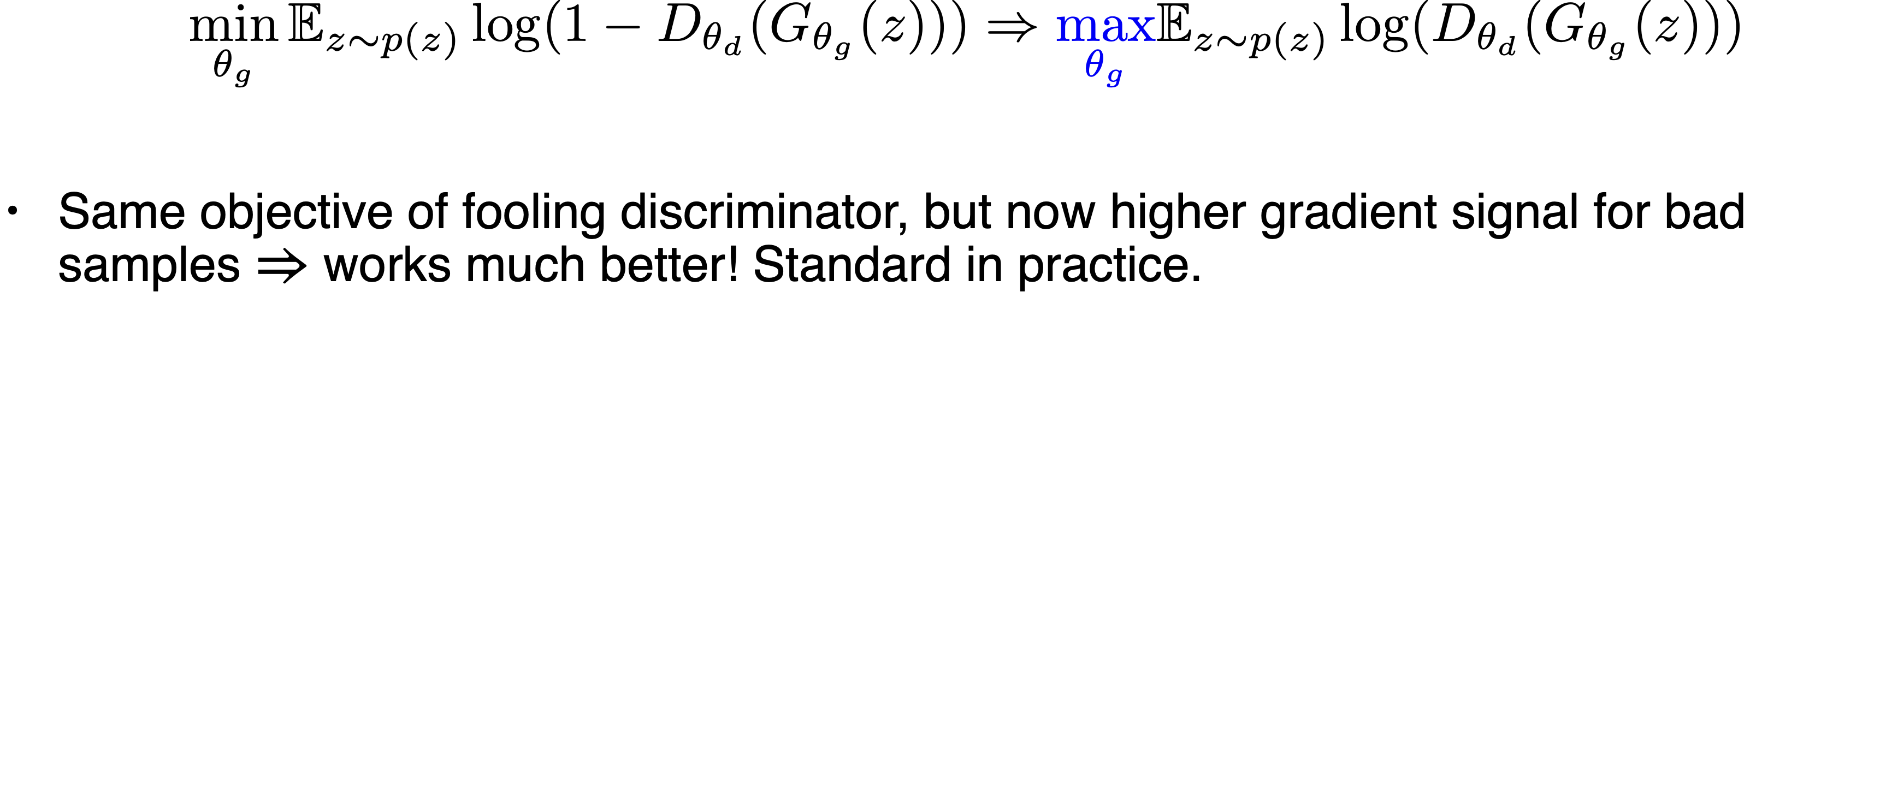
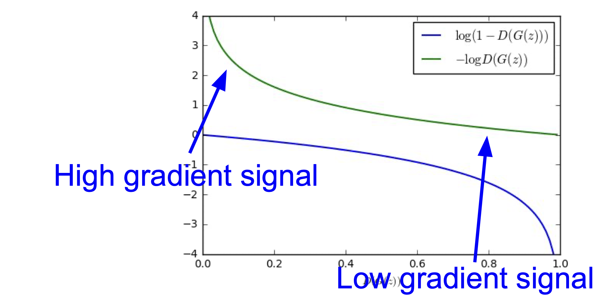
Review

Slide 16
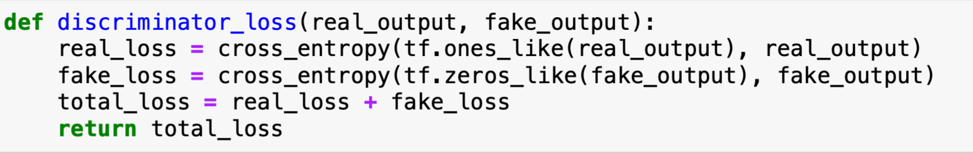

Slide 17
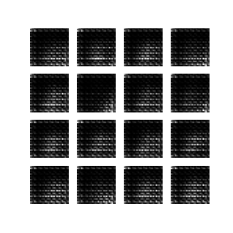
Today’s goal

Slide 18
Thank You :)
jsheo12304@postech.ac.kr

